Slide 1


Capacity Optimization Tool:
What you should expect from a good capacity optimization tool
and a surprising benefit of having a good tool
Presented to you by:
BEN DAVIES
We make heavy use of the comments section. Download the presentation for that data.
Notes:
Good afternoon.
Welcome to the St Louis CMG meeting, and our presentation “What you should expect from a good capacity optimization tool and a surprising benefit of having a good tool”.
This is a conversation about what to expect from a capacity optimization tool. We use BMC TrueSight Capacity Optimization in our examples but that tool is not the focus. And we discuss that with good tool and various data inputs, the tool becomes a unique dataset "different and apart from the sum of its parts", which provides significant business value, independent of the original capacity mission.
I am Ben Davies a consultant from Movìri Consulting, and I have been doing computer stuff for some 30 years, about ten of that in capacity planning of one sort or another.
Movìri, or more accurately the company that became Movìri wrote a good capacity optimization tool, that was purchased by BMC and became what is now knows and BMC TrueSight Capacity Optimization.
Some of that is full disclosure, and some of that is to suggest that we have a clue on the topic.
===
Mr. Ben Davies
Senior Consultant
www.Moviri.com
283 Franklin St, Floor 2, Boston MA 02110-3123
Office +1 (704) 819-7892
Ben.Davies@moviri.com

Slide 2
Agenda
Define our Purpose/ Goal of Capacity Management
Keys to achieving the Goal – A good tool
A good tool delivers Reports and Actionable Intelligence
Gestalt Psychology (yes it applies!)
Summary and Capacity Management “Must Haves”
Questions
Notes:
Our goal today is to discuss capacity management as a discipline and in the context of a capacity tool, in this case the BMC TrueSight Capacity Optimization 11.x solution is shown in the examples. We will not focus on this tool as a sales pitch, but to show what a good tool should do for you.
We are going to assume that you know of Capacity Management but are not a capacity expert. Also we will assume you understand that what we show in the tool should be part of any capacity tool you use. While I am biased toward the BMC TrueSight Capacity Optimization solution, there are other tools available, including good ole Microsoft Excel – which is where I got my start.
With that understanding we will:
Define our Purpose / Goal of Capacity Management
Explore the keys to achieving that goal
Talk about reporting to deliver actionable intelligence
Take a diversion into Gestalt Psychology – it is relevant here
Then summarize our must haves
And finish with questions.

Slide 3
Purpose / Goal of Capacity Management
“Transparently and consistently arrive at useful capacity optimization insights, in a reasonable amount of time, with reasonable effort, and in enough time to effect a positive capacity management outcome.”
The goal is not ‘Zero Waste’ but Efficient Utilization
$
Multiple Data Sources
Single Holistic View
Hard Savings
Capacity Insights
$
Soft Savings
Notes:
In my estimation, the purpose / goal of a capacity management effort is to: “transparently and consistently arrive at useful capacity optimization insights, in a reasonable amount of time, with reasonable effort, and in enough time to effect a positive capacity management outcome. ” The goal is not ‘zero waste’ but rather efficient utilization.
The key to achieve this is to consolidate your capacity data into one place where this data can be seen / evaluated holistically. A good capacity optimization tool is the enabling technology, along with complete data.
When your environment (or the part you were responsible for) was ‘small’ , which is to say up to a couple hundred devices, you could keep this data ‘in your head’ reasonably effectively. As the counts increase, things start to slip. Once this becomes apparent, it is already costing yourself considerable green money for equipment, power, cooling and licenses, as well as blue money for the people, time and effort to manage them.
A good tool will help you to quickly save green money by showing resources that are currently available but out of view. This allows for you to confidently place new demand on existing equipment and save green money, by not spending green money resources for additional capacity.
It also shows you where you have old, under used, and ‘lost’ resources that are ripe for retirement and consolidation. This saves the blue money that is currently used for the care and feeding for resources that are providing limited value. While you are not going to recoup blue money already spent on licenses, you do free those licenses up, which potentially is a green money savings when the license is renewed.
So it seems to reach our stated objectives of: green money savings, blue money savings, and useful capacity optimization insights, we should start with an inventory of Capacity data sources, which is more than just monitoring data.

Slide 4
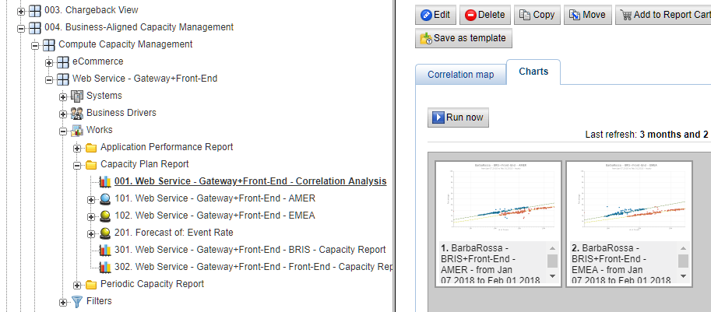
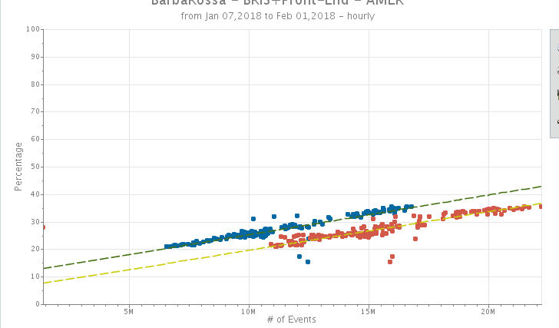
Fancy Correlation Analysis
Notes:
Your tool should have the ability to make fancy analysis relatively easily. In this case (test data so don’t look so close) we see number of events vs CPU percentage needed to service those events. You can use a chart like this to determine how many events you could process with less than 50% CPU, or if a 25% increase in work will fit on existing equipment.
This analysis takes considerable analysis time. It is important that the capacity tool can make these charts quickly and easily, as many iterations are needed for a complete analysis.
===
For a true capacity optimization effort, we need to know the counts of work that those devices are doing. When we know those counts we can make declarative statements like for every 100 pieces of work per minute, the systems involved use xx CPU require xx memory, and consume xx network IO, xx disk IO, and xx storage space.
To the extent that this remains true in our model, we forecast that we can service up to xxx pieces of work per minute with the first constrained resource is ???.
These counts of work come from log data, transaction databases and other sources and are hugely helpful in maturing any capacity optimization effort.

Slide 5
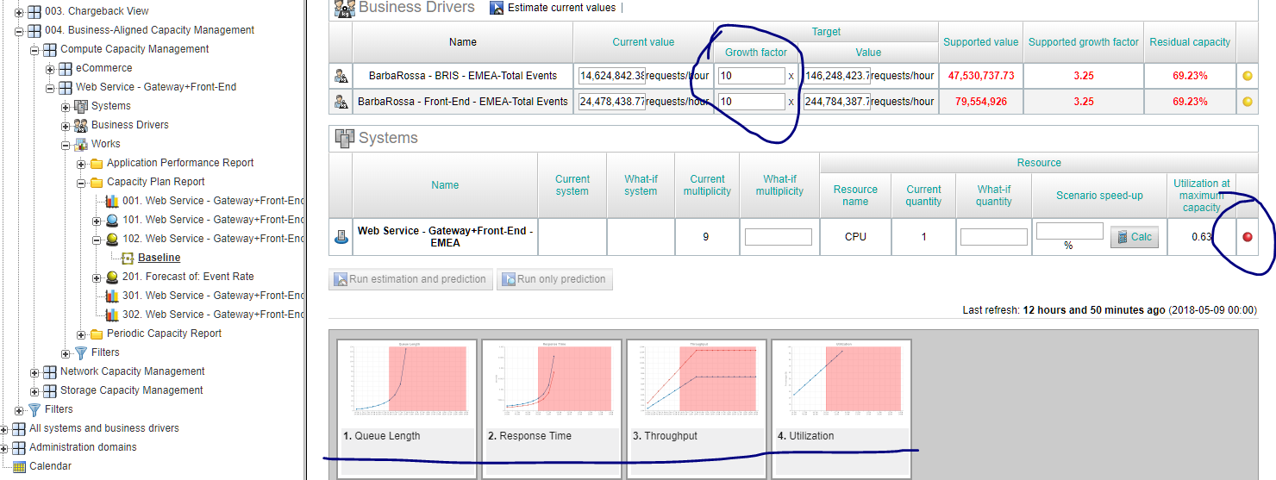
Capacity Analysis and What IF Modeling
Notes:
Your capacity optimization tool should have the ability to model existing efficiency, AND model increase load. This will show the next bottleneck. The analyst can then propose ways to remove the bottleneck with new, or bigger, or different equipment – all of which have a cost that can now be evaluated.
This allows us to say that for xxx $Dollars we can relieve that constraint in our forecast, allowing us to service up to xxx pieces of work per minute, where the next constrained resource is ???. And so on and so on.

Slide 6
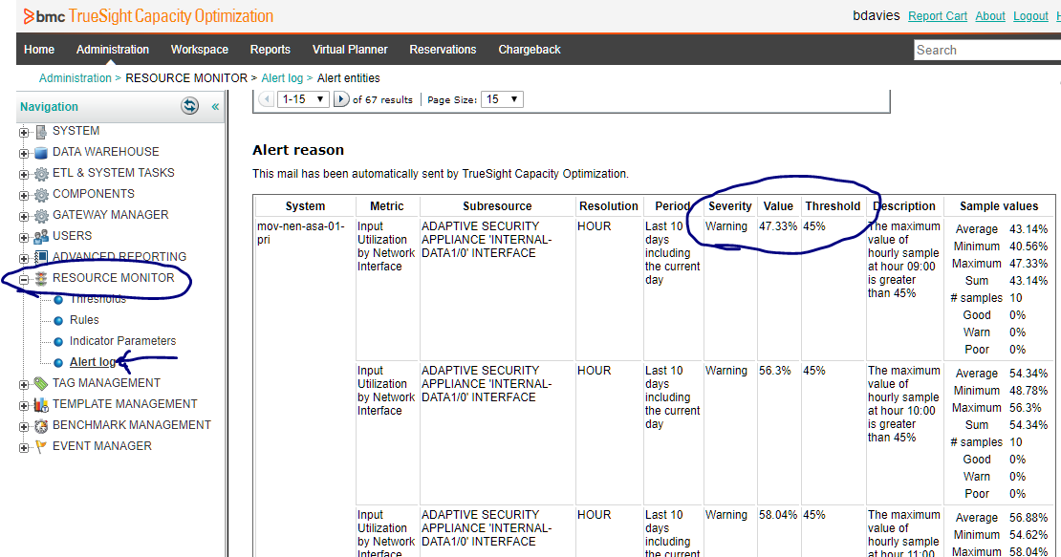
Threshold Violation Reporting
Notes:
Your tool should have the ability to monitor for ‘threshold violations’ This sample is a verbose report showing each violation of a threshold.
Your tool will likely have preset thresholds. It is up to you to tune them for your environment. (not too many false positives without missing valid leading indicators.)
These analysis are quite mature. And are NOT something you are likely to get as soon as the tool is turned on. But your tools must be able to do these analysis easily and quickly.
This analysis required a ‘reasonably complete’ compute profile (monitoring data), counts of work done in a granular enough slices to compare to the equipment, and a grouping mechanism to isolate these data into an application or service, and an application SME to interpret the systems and interactions.
To be clear the tool can do this on day one, but the data required is generally not available early in a new effort.

Slide 7
So if these (preceding) studies take time,
what can I do right away??
Notes:
So if these (preceding) studies take time, what can I do right away??

Slide 8
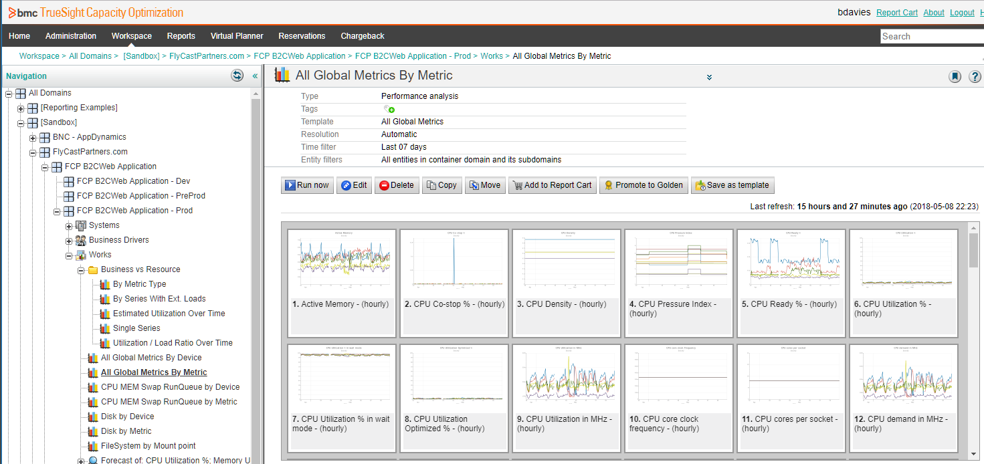
Actionable Intelligence Based on Grouping
Notes:
As soon as you get monitoring data into the tool you start making ‘canned reports’.
These canned reports are intended to discover what actionable intelligence is within the data.. In this example we group based on Operating system, monitoring tool, or some manually created ‘buckets’
From ‘Day One’ the capacity team should be able to generate useful ad-hoc reports.
These reports can and should show common metrics, but can also show uncommon metrics. Test your tool and data by looking for Common Metrics:
CPU
Memory
Disk
And also uncommon metrics
Co-Stop a VMWare metric (discussed later)
Minimum idle workers – an Apache metric
CPU RunQueue
file descriptors (ulimit)
network port mismatch
Database locking

Slide 9
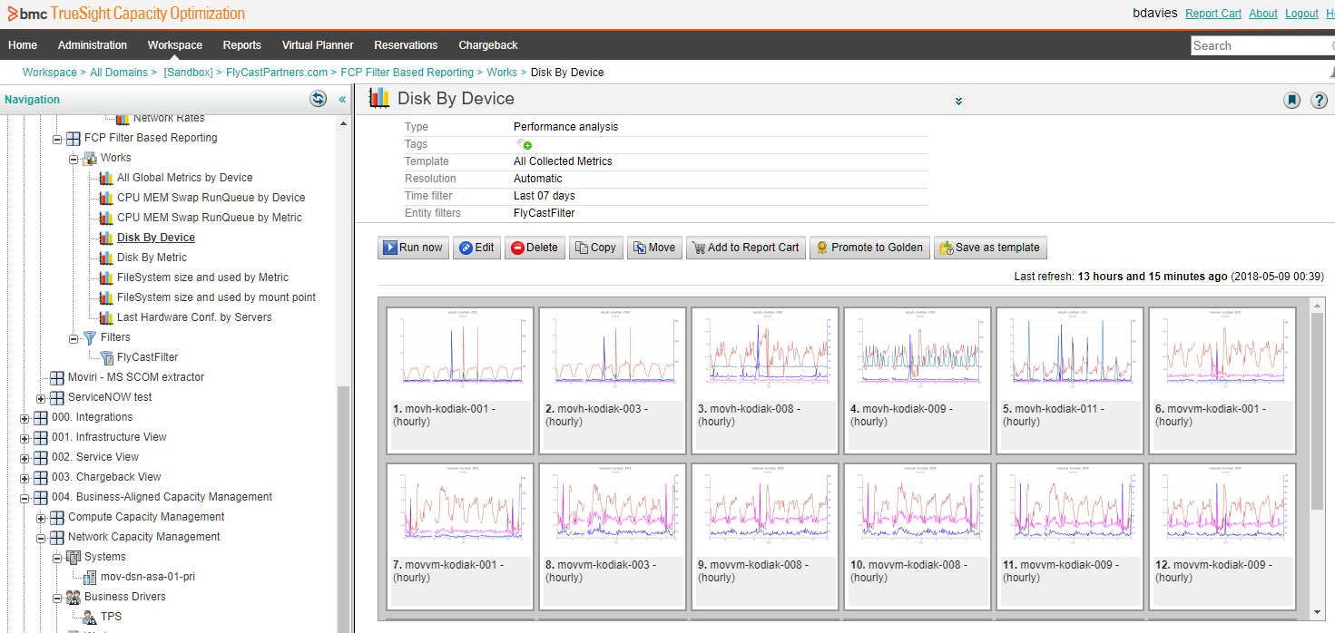
Actionable Intelligence Based on Filters
Notes:
Your tool should also be flexible enough to group on the fly. We do this based on filters in our example. Reports are made in advance, and as items get our attention, we put them in the filter, and run the reports.
Your tool should not force you to predefine everything every time.

Slide 10
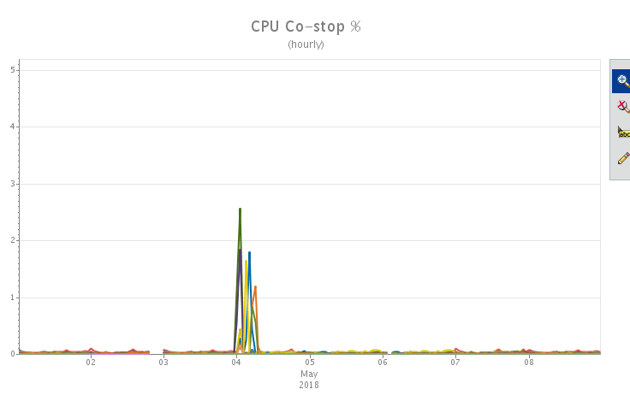
The goal is not ‘Zero Waste’ but Efficient Utilization
Notes:
Now don’t get carried away with eliminating waste.
This is a Co-Stop chart implying that this environment is ‘over provisioned’ and a capacity manager would be tempted to ‘right size it’ to the average utilization.
However, this site services our demos. And for THAT mission we need a responsive system while under load of a few dozen users for a relatively short time.
A capacity manager that does not let his work get in the way of his mission would see that ‘right sizing’ for the average saves a few hundred dollars a month on hardware. But when the system is needed, it needs to be responsive, directly supporting a level of ‘customer satisfaction’ needed to deliver sales, which delivers much more upside that could be saved by striving for zero waste.
So remember your capacity management goal is not zero waste, but rather is efficient utilization. Zero waste is a much easier goal than efficient utilization which takes monitoring and business data, system understanding, business aware analysis, and capacity optimization expertise.

Slide 11
This is great! So where do I start??
DATA. Data is where you start.
Notes:
This is great! So where do I start??
DATA, Data is where you start.

Slide 12
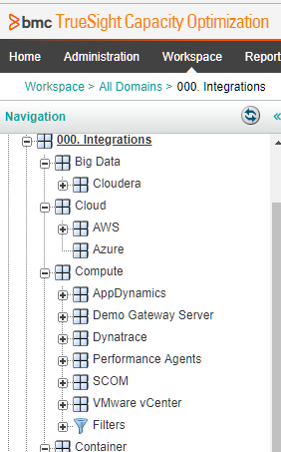
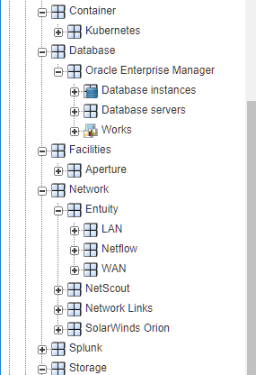
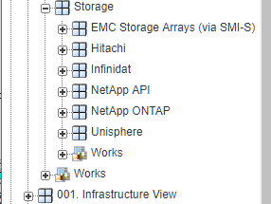
Gather Data from Sources
Single Holistic View
Notes:
So what data is needed and from where?
When choosing a tool it is ‘nice’ if it can eat 200 different data sources, but really the ones that matter are the ones YOU USE (and are going to get data out of). Don’t ignore non monitoring data sources. Data sources that have counts of work, configuration data, fact data (like the official definition of approved applications and services), and other lookup data.
In our example tool, this is a tree section called “000 Integrations” and is one long column (not the three segments shown). This is the ‘home’ for the equipment that is being monitored by your monitoring tools. As you can see, we are eating data from a bunch of different sources.
Dynatrace, AppDynamics, VMWare, database, facilities, network, storage, and Splunk among others. Splunk is a very powerful data source for getting data from log files and such.
The capacity optimization tools should find systems and objects that are the same and have them augment each other. So webServer001 as seen by VMWare data source should collide with webServer001 as seen by Dynatrace data source, and the data sources augment each other. This is a huge advantage to using a capacity optimization tool so your tool MUST support this easily.
This is a good place to mention that the capacity optimization tool will NOT displace or replace any of the monitoring tools you have in place now. You will still need those tools for the monitoring, real time alerting, and for happening now investigations.
It is also a good time to mention that not all metrics at the finest resolution should be sent to your capacity tool.
====
As a side note – your equipment managers and monitoring teams will NOT be early customers of the capacity management tool.

Slide 13
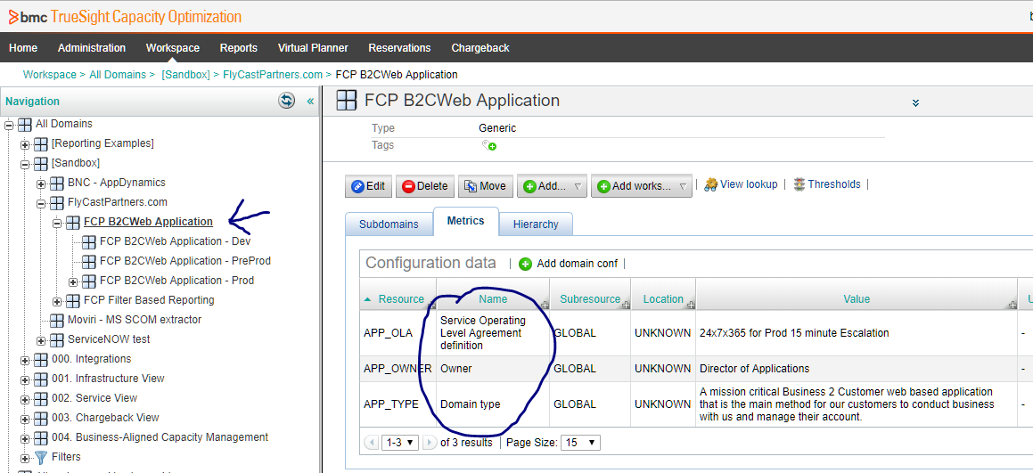
Incorporate Other Data
Notes:
It REALLY helps to have an association table to assemble the equipment into useful groups like applications, services or however you divvy up responsibility in your organization. Typically this is a CMDB or Configuration Management Database.
When we say that most people say. “ Dude, we have a dozen of them, and they are all incomplete / wrong / out of date / special use / whatever”
My reply: “Documentation is useful to the extent it gets used, and is used to the extent it is useful.” Yes this is the chicken and the egg argument but, you can use it in your capacity efforts. Specifically each CMDB can be a branch in your navigation tree. The world according to XXX CMDB. Most importantly those CMDB’s augment each other within the capacity optimization tool.
Now that those CMDBs have an external customer (which is you and your customers), more effort may be invested to mature the data by the data owners. You may even find, as I did, that when this helpful but difficult to find data is made available in your capacity optimization tool, it encourages the data owner to maintain the source data.
As an example we have CMDBs that reliably shows the Application description, and one for owner and one for OLA and those pieces of information were combined in our capacity optimization tool. Our tool should be able to accept that data to make the interface of the capacity optimization tool that much more helpful, buy being the ‘single pain of glass’ for all this dispersed data, and gives it some context
Your tool should have the ability to incorporate this configuration data. In this example, the command center gets an alert on this application, and the capacity tool shows them what the Operating Level Agreement is, who owns the application and an official description of the application, with out needing to refer to three separate tools.
Now a much better informed escalation process can be made. This data is available in other tools, but they tend to be just to darn hard to get to.

Slide 14
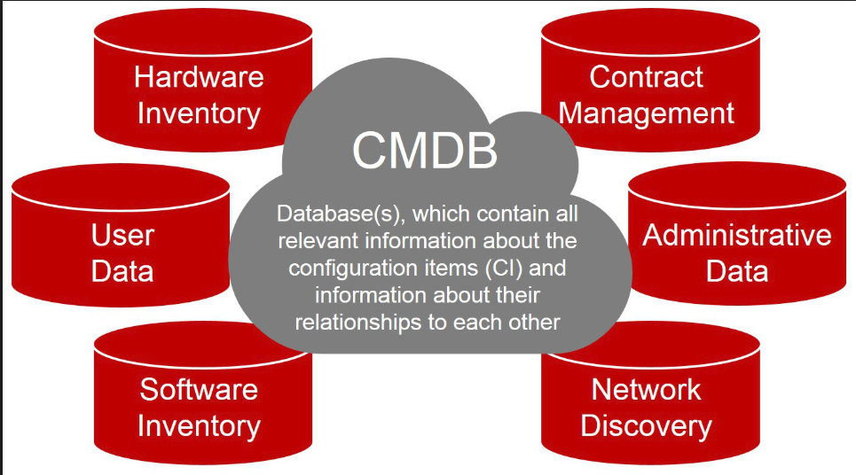
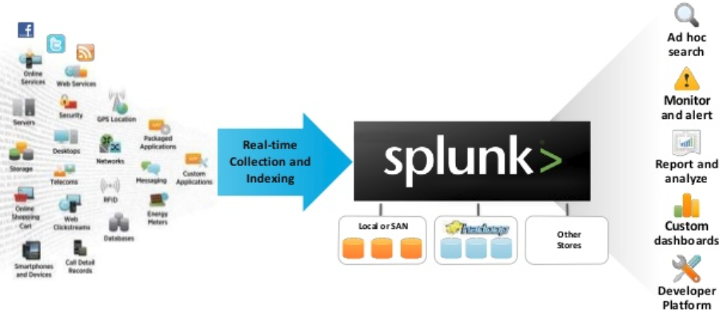
Indirect Data Sources
This context and association data is disproportionately helpful
in maturing the capacity optimization effectiveness
Notes:
Special mention for your capacity optimization efforts, don’t miss Indirect data sources like Splunk, and your CMDBs.
Splunk is a great source for business metrics (count of work). Taking access logs and counting sessionID; or security logs and counting login events; or middleware logs and counting product sales.
The CMDBs provide significant value by associating devices into groups (applications and services), providing contextual data. This context and association data is disproportionately helpful in maturing the capacity optimization effectiveness

Slide 15
Different and apart from the sum of its parts
"the whole is something else than the sum of its parts"[2] is often incorrectly translated[3] as "The whole is greater than the sum of its parts", and thus used when explaining gestalt theory, and further incorrectly applied to systems theory.[4] Koffka did not like the translation. He firmly corrected students who replaced "other" with "greater". "This is not a principle of addition" he said.[5] The whole has an independent existence.
---https://en.wikipedia.org/wiki/Gestalt_psychology
Notes:
With all of these inputs, the capacity tool now has a completely unique data set. Different and apart from the sum of its parts. (Gestalt psychology) The parts are the monitoring tool data, association data from CMDB, fact data from CMDB, business counts of work or business metrics from SPLUNK (which came form logs). It is not uncommon to have 100 data sources.
The capacity optimization solution has the unique ability to consolidate all of this data you have spent millions of dollars and thousands of hours to obtain, and store, and can liberate it to other legitimate business purposes.
When I was a capacity planner, we had a couple of hundred users of our tool, and about a hundred were frequent users including change management, help desk, command center, application owners, application SMEs, and technical staff. My users got so much value out of the data supplied by these data sources, especially the various CMDBs, that some tools that were going to be retired, because ‘no one used the data’, were kept because the data was now being used through our tool.
Most people do not know that they have access to the CMDBs, log files, and monitoring tools, and even if they did know, the interfaces do not lend themselves to a casual user getting occasional data. Once this data was in our capacity optimization solution, that data found a new audience because our interface made access to that data ‘easy’.
Having this data assembled in ONE PLACE, with a user friendly interface creates a unique and valuable data set, different and apart from the sum of its parts. And this became a major value proposition to the corporation, completely independent of the original capacity optimization mission.
Anyway this is FREE VALUE. Available to internal customers that care nothing about ‘capacity management’. Evaluate your tool with this use case in mind.

Slide 16
Summary
“Transparently and consistently arrive at useful capacity optimization insights, in a reasonable amount of time with reasonable effort and in enough time to effect a positive capacity management outcome.”
Consolidate data to one place.
Eat the data you have from the sources you have
Do the fancy correlation analysis and what if modeling
Import other data – like from CMDBs
Threshold violation reporting
Group in ways that facilitate reporting (by application, service, location etc)
Provide actionable intelligence with anomaly detection and ad-hock customer reporting
Recognize goal is not ‘zero waste’ but rather Efficient Utilization
Notes:
Lets summarize.
The purpose of a capacity management effort is so that you can “transparently and consistently arrive at useful capacity optimization insights, in a reasonable amount of time, with reasonable effort, and in enough time to effect a positive capacity management outcome. ” The goal is not ‘zero waste’ but rather efficient utilization.
To achieve this you should consolidate your capacity data into one place where this data can be seen / evaluated holistically.
Must do the fancy correlation analysis and what if modeling – otherwise you are back in your head or in Excel
Must be able to quickly report on ad-hock anomaly detection and ad-hock customer reporting to deliver actionable intelligence.
Must be able to collide on system names such that the data is augmenting on a device name and delivering the value beyond the sum of its parts
The solution must eat the data from the data sources you have. Don’t ignore non monitoring data. CMDB for organization, context and fact data, as well as business metrics or the count of work from a tool like Splunk.
As you add various data types, you will find that your capacity tool now has a completely unique data set. Different and apart from the sum of its parts. (Gestalt psychology) Don’t underestimate the Corporate Business Value this can provide.
The tool needs to be easy enough that non capacity managers can get value out of this uniquely central data source.
There ya go. This is what you should expect from a good capacity tool, and a surprising benefit of having a good tool.
A capacity management tool, like BMC TrueSight Capacity Optimization can help with these goals.
And partners like Movìri Consulting can help you effectively achieve YOUR capacity optimization goals.

Slide 17
Mr. Ben Davies
Senior Consultant
www.Moviri.com
283 Franklin St, Floor 2, Boston MA 02110-3123
Office +1 (704) 819-7892
Ben.Davies@moviri.com
Notes:
Movìri Consulting thanks you for your time. Give us a call to see how we can help you achieve your goals.
Mr. Ben Davies
Senior Consultant
www.Moviri.com
283 Franklin St, Floor 2, Boston MA 02110-3123
Office +1 (704) 819-7892
Ben.Davies@moviri.com

Slide 18
Questions?
Why are my monitoring tools not enough?
Why have I never heard of
Co-Stop - VMWare
Minimum idle workers - Apache
CPU RunQueue
file descriptors (ulimit)
network port mismatch
database locking
Why should pay attention to these, and how did I miss them.
I am not yet doing ‘anything’ with capacity management. How should I get started?
I am doing capacity management now. I do not wish to throw it out and start over.
Download the presentation for the answers
Notes:
Questions? Here are a few
Why are my monitoring tools not enough?
They may be ‘enough’ for monitoring but probably not for capacity planning. While you could do individual device capacity analysis, these monitoring tools tend not to be able to groups systems together to analyze the group and they can not include data that is from a different source. You would have to go to that source and perform capacity analysis on those systems in isolation.
So. The mission of capacity planning is GREATLY enhanced by combining these separate monitoring tools data and conducting capacity analysis on the combined group of resources.
====
I am not yet doing ‘anything’ with capacity management. How should I get started?
Mature your data sources. This means to identify the source. Establish a path (network rules, firewall rules). Establish a read only account (not a person account but a process account). Get access to the database tables, and sample queries. The goal here is to connect with Excel ODBC functionality, use a query to get yesterdays data in the proper time slices and denormalized so you have device names not just device serial numbers. Review the data to be sure that it includes what metrics you wish, at the proper resolution and in a way that can be analyzed in the tool, even if it ‘only’ Excel. You can start this process right this instant with what you already have on your desktop. As you shop for tools this process will mature the data sources, let you get familiar with the data, and get started on basic analysis. When your tool is installed connecting to these data sources will be ‘super simple’ (compared to not maturing the data sources first).
====
I am doing capacity management now. I do now wish to throw it out and start over.
It is likely that this is not necessary. We can evaluate what you are doing now and recommend adjustments. Mostly the tools and techniques apply across software tools, so unless the software tools you are using now do not meet critical success criteria, you may just need to make adjustments. We have the experience of seeing what has worked and what has not in a number of different sized environments and with various political environments. You can benefit from that experience.
====
Why have I never heard of …
Capacity management has become a progressively complicated world with constantly changing parts. In the beginning of physical systems, CPU was the constrained resource. Then as devices became bigger several workloads were placed on one device, causing work characterization to be the topic of the day. Then as the devices got bigger still and virtual machines allowed for simplification of workload characterization, memory became the constrained resource, while the physical devices became virtually hidden. Each technology change addresses some challenge, but moves the goal posts of capacity management. In all of this many metrics have a finite application, and we find them only during complicated performance analysis.
Now Capacity managers can find these obscure metrics during conversations like this, and monitor them easily with a capacity tool (that collects the metrics). It is an information arms race and these gems tend to stay hidden until the ‘normal stuff’ is addressed in the capacity management efforts. Finding these metrics is how you know you are doing interesting stuff. ☺
Do research on the metrics and see if your capacity management practice would benefit from monitoring these metrics. Short answer is yes.

